Slide 1
ELECTION DATABASE
E/19/133 A.HARISHANTH
E/19/133 T.HAYANAN
E/19/371 M.SANTHOSH

Slide 2
Abstract:
Huge data flow in an election period.
Entities:
Voters
Candidates
Political Party
Polling Station
Election Committee
Election
Ballot
Election Result
Committee Member
Polling Station Team
Each Entities Related to each other in some way.

Slide 3
Some important relationship between the entities
Candidate and vote entities are linked in one to many relation. A candidate can have many votes but a vote cannot have many candidate.
Voter and vote are also connected with one to many relation. A voter is allowed to make more than one vote but each vote has to be made by one voter.
A polling station can have many votes but those votes has to be made in one polling station. Therefore, they have one to many relation between them.
An election can have many candidates but each candidate can be compete in a single election at a time. They also related with one to many relation.
A candidate can be associated with only one party while a party can have many candidates as it can. So they also have one to many relation between them.

Slide 4
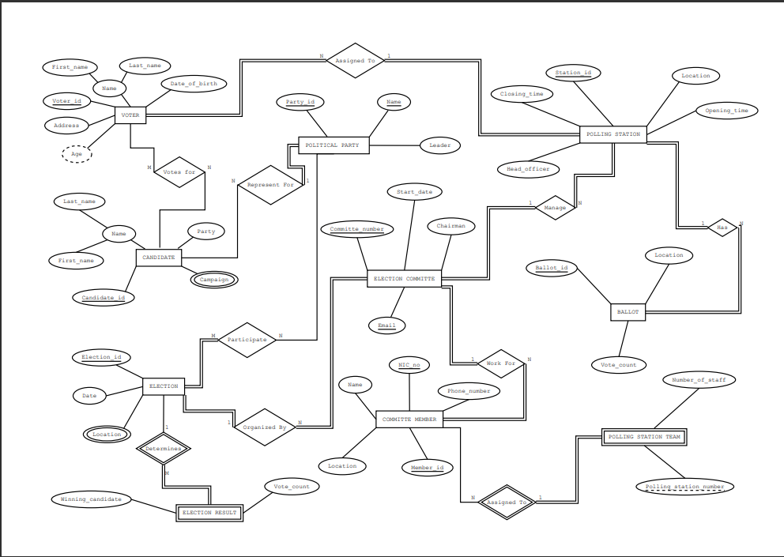
ER Diagram
ER Diagram

Slide 5
Relational Mapping
POLITICAL_PARTY | Party_ID | Name | Leader
VOTERS | Voter_ID | F_Name | L_Name | DOB | Address | Age | Station_ID
CANDIDATE | Candidate_ID | Party | F_Name | L_Name | Party_Name | Party_ID
VOTES_FOR | Voter_ID | Candidate_ID
POLLING_STATION | Station_ID | Location | Open_time | Close_time | Head_Officer | Committee_NO | Com_Email
CAMPAIGN | Candidate_ID | Campaign_Name
BALLOT | Ballot_ID | Location | Vote_count | Station_ID

Slide 6
ELECTION | Election_ID | Date
ELECTION_LOCATION | Electon_ID | Location
ELECTION_RESULT | Election_ID | Win_Cand | Vote_Count
PARTICIPATE | Election_ID | Party_ID | Name
COMMITE_MEMBER | NIC_no | Member_ID | Name | Location | Phn_No | Com_No
POLLING_STA_TEAM | Memb_NIC_No | Mem_ID | No.of_staff | Polling_Station_no
ELECTION_COMITTE | Email | Committee_No | Chairman | Start_Date | Election_ID

Slide 7
THANK YOU

